Slide 1


Retail Sales Analysis: Trends, Seasonality, and Insights
This presentation explores retail sales data through exploratory data analysis, seasonality trends, and feature correlations. We identify key sales drivers, holiday impacts, and top-performing stores to inform strategic decisions. Our goal is to optimize inventory, promotions, and forecasting models for improved sales performance.
by Shubham Raut

Slide 2
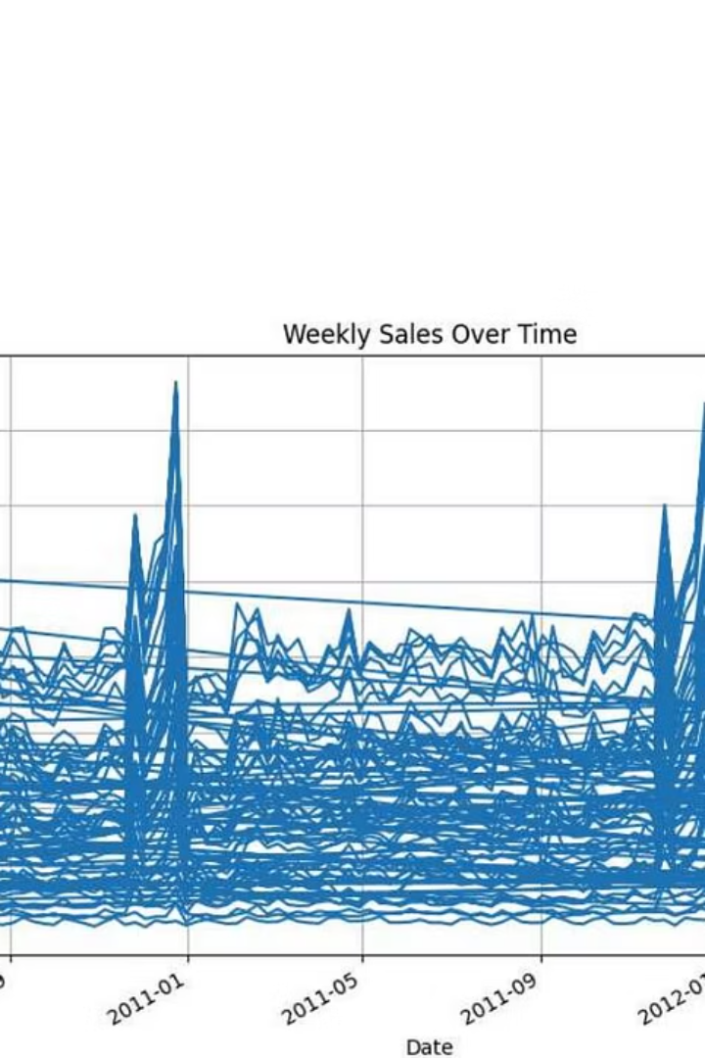
Exploratory Data Analysis (EDA) Overview
Sales by Store
Sales by Department
Barplot shows total weekly sales by store, highlighting high and low performers.
Department-level sales analysis reveals contribution to overall revenue.
Key Insights
Seasonality boosts sales; studying top stores can help replicate success; store format impacts profitability.

Slide 3
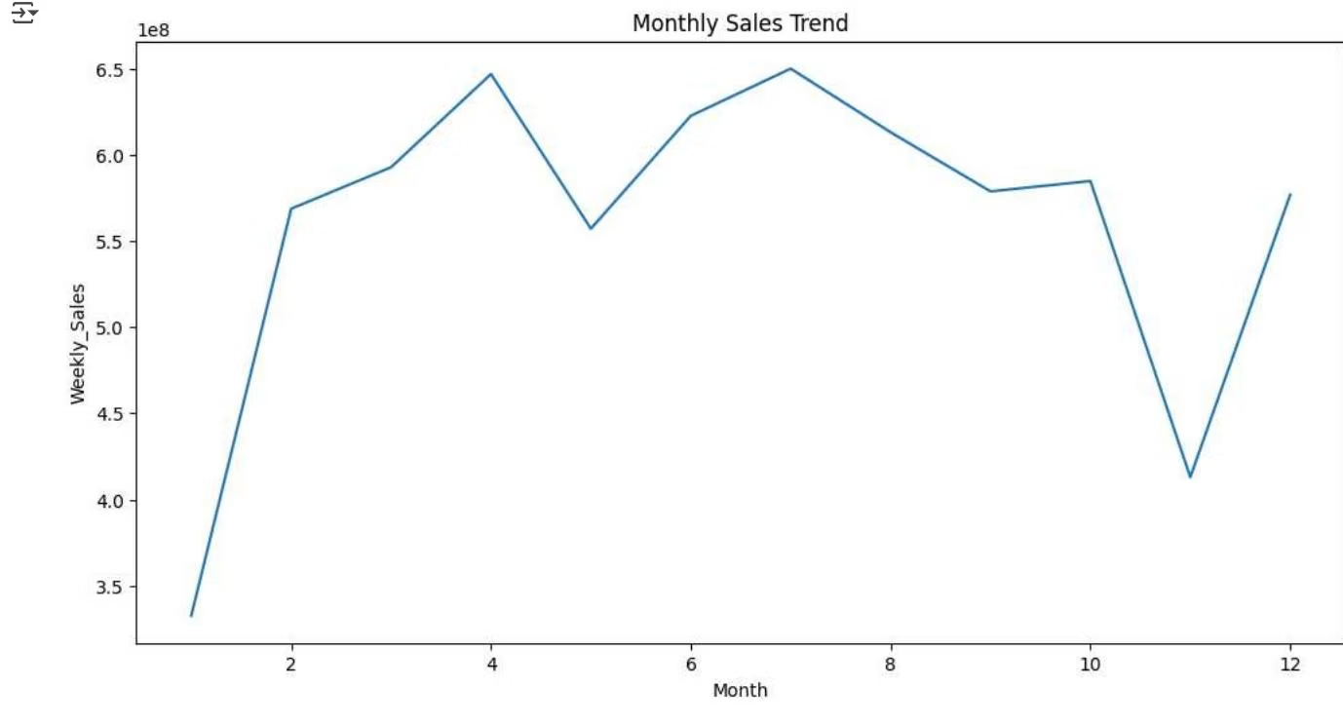
Seasonality & Monthly Sales Trends
Monthly Sales Pattern
Holiday Impact
Sales peak in April and July, indicating strong mid-year promotional impact.
Boxplot analysis shows increased sales during holidays, useful for demand forecasting and planning.
November shows a dip, possibly due to pre-holiday sales lull, followed by recovery in December.

Slide 4
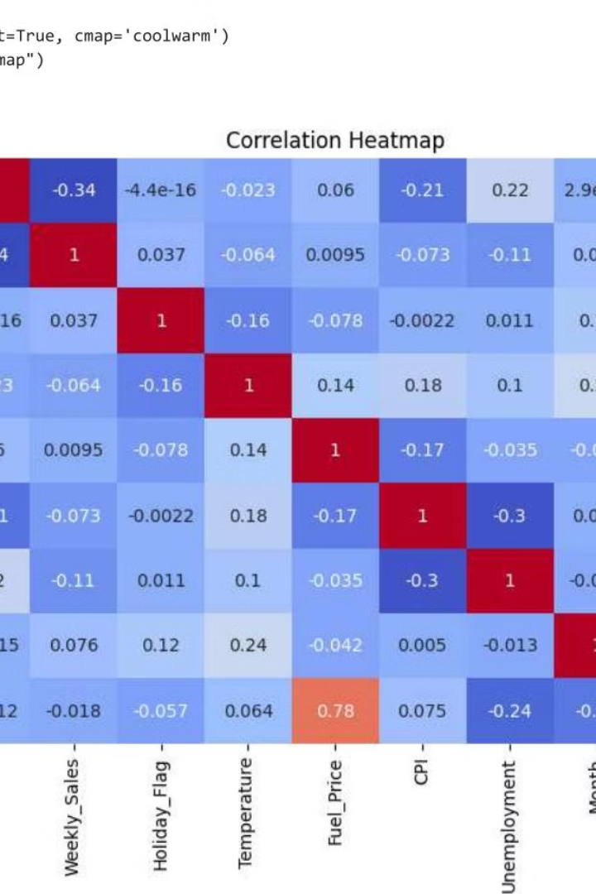
Correlation Analysis of Sales Factors
Weak Sales Correlations
Weekly sales show weak correlations with other variables, indicating complex drivers.
Unemployment Effect
Slight negative correlation (-0.064) suggests sales dip in poor economic conditions.
Holiday Flag Impact
Minimal effect (0.037) on overall sales, indicating holidays alone don't strongly drive sales.
Fuel Price & Year
Strong correlation (0.78) reflects rising fuel costs over time but limited direct sales impact.

Slide 5
Sales Trend and Top Performers
Seasonal Sales Variation
Top Stores & Departments
Sales fluctuate seasonally with peaks around holidays and promotional periods.
Consistent outperformers can be prioritized for inventory and marketing efforts.

Slide 6




Holiday Sales Impact and Demand Forecasting
Holiday Sales Increase
Sales tend to rise during holiday periods, supporting targeted promotions.
Demand Forecasting
Holiday indicators can improve accuracy in sales forecasting models.
Planning Strategies
Focus inventory and marketing around holidays to maximize sales potential.

Slide 7

Strategic Recommendations for Sales Growth
Focus on Holidays
Align inventory and promotions with peak holiday seasons for maximum impact.
Invest in Top Performers
Prioritize resources for high-performing stores and departments to boost overall sales.
Develop Forecasting Models
Use month, year, and holiday data as key predictors to improve sales predictions.

Slide 8
Summary and Next Steps
Key Takeaways
Next Steps
Sales show strong seasonality with holiday peaks.
Implement targeted promotions during peak months.
Top stores and departments drive consistent performance.
Analyze top performers for best practices replication.
Holiday impact on sales is moderate but useful for planning.
Enhance forecasting models with seasonal and holiday data.

